Slide 1
TARDIS
The Doctor’s Tardis lands on the Red Planet.
There is only red light.
POLICE BOX
PUBLIC
CALL
POLICE TELEPHONE
FREE
FOR USE OF
PUBLIC
ADVICE & ASSISTANCE
OBTAINABLE IMMEDIATELY
OFFICERS & CARS
RESPOND TO ALL CALLS
PULL TO OPEN
I

Slide 2
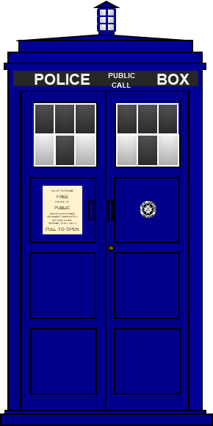
TARDIS
1. What colour will the TARDIS look on the Red Planet?
Blue
Red
Purple (magenta)
Black

Slide 3
TARDIS
2. Why do you think it looks this colour?
There is only red light
Blue does not reflect red light
The paint is blue
The eye adds the red light to the blue

